Slide 1
Monday, March 14, 2022

Slide 2
XSL From the Ground Up
Michael Hanson
Software Trainer

Slide 3
Prerequisite
Basic knowledge of HTML and CSS

Slide 4
Overview
Basic concepts of XML and XSL
Transform and render XML into required output

Slide 5
XML Basics
XML (Extensible Markup Language)
Used to store data as text
markup language similar to HTML, but without predefined tags to use and stricter syntax rules
define your own tags designed specifically for your needs
Structure of an XML Document
Must contain single root node
XML Declaration (optional) - declares that a document is an xml document and describes its version, must be the first statement in an xml document
<?xml version="1.0" encoding="UTF-8"?>
All elements must have a closing tag (or be self-closing).
Tags are case sensitive
Attributes must be quoted. Attribute values cannot be minimized
<select name=“course” disabled> is invalid, use <select name=“course” disabled=“disabled”>
All elements must be properly nested inside of each other

Slide 6
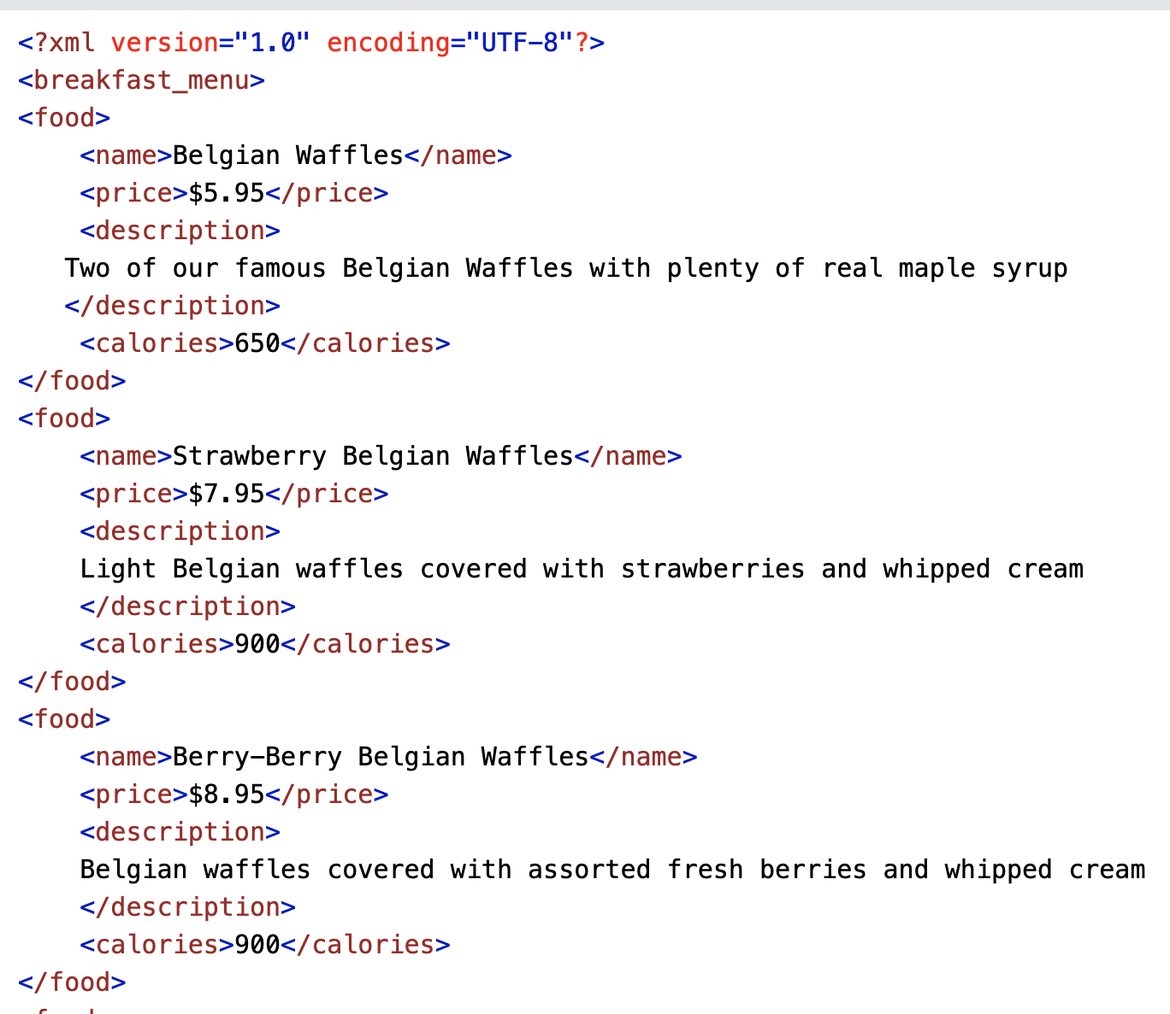
XML Example Source: w3schools.com

Slide 7
XML Basics
Entity References
The following characters have special meaning in XML
To avoid errors replace it with the entity reference
Symbol | Entity Reference
< | &lt;
> | &gt;
& | &amp;
‘ | &apos;
“ | &quot;

Slide 8
XSL Basics
XSL(Extensible Stylesheet Language)
Styling language for XML
Three parts of XSL
XSLT – instruction elements that starts with “<xsl:”
– transforms XML document into different types of document (e.g. html, php, etc.)
XPath – syntax and functions for navigating and manipulating XML structures
XSL-FO – XML vocabulary for document formatting (FO = Formatting Objects)

Slide 9
XSLT
eXtensible Stylesheet Language Transformations
Transforms XML into any required output
Builds on XPath
Works by applying templates to XML data.
Learn more at https://www.w3.org/TR/xslt/

Slide 10
XSLT Stylesheet
Uses XML syntax
1 <?xml version=“1.0” encoding=“UTF-8”?>
2 <xsl:stylesheet version=“1.0” xmlns:xsl=“http://www.w3.org/1999/XSL/Transform”> 3 <xsl:template match=“/”>
. . . .
Line 1: XML Declaration
Line 2: XSL Stylesheet tag(can be replaced with <xsl:transform>), xslt version and XSLT namespace declaration
Line 3: XSL template declaration. Uses XPath expression to match the content in the xml file.
/ matches the document root element, entire document will be processed.

Slide 11
XML File and Stylesheet
Associate the stylesheet with the xml file by adding the xml-stylesheet tag after xml declaration
<?xml version="1.0" encoding="utf-8"?>
<?xml-stylesheet type = "text/xsl" href = “training.xsl"?>
<COURSES>
<COURSE>
<INFORMATION>
<DESCRIPTION>Introduction to accounting concepts. (2 lecture hours)</DESCRIPTION>
<TITLE>Bookkeeping - a Practical Focus</TITLE>
<COURSENO>0430</COURSENO>
<CRSMINCRED1>2</CRSMINCRED1>
<DEPARTMENTNAME>Accounting</DEPARTMENTNAME>
</INFORMATION>
</COURSE>
</COURSES>

Slide 12
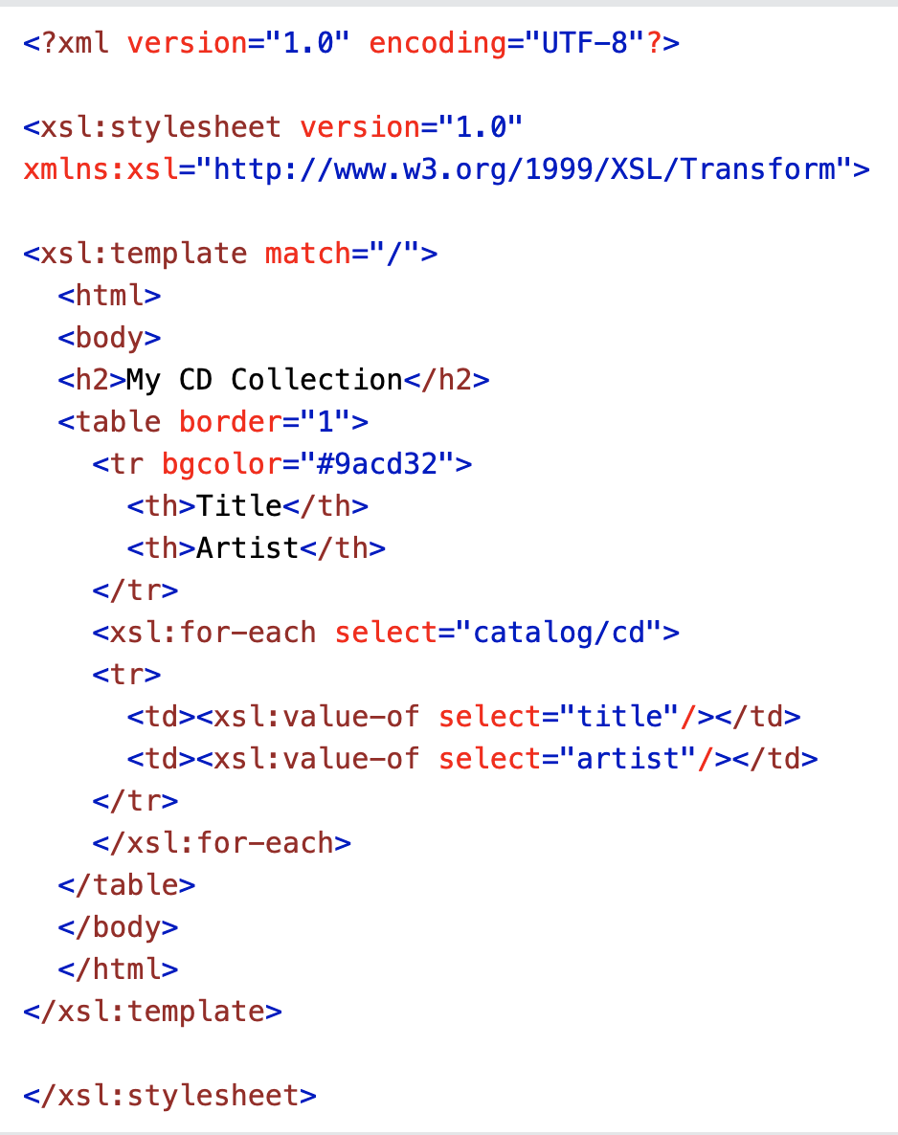
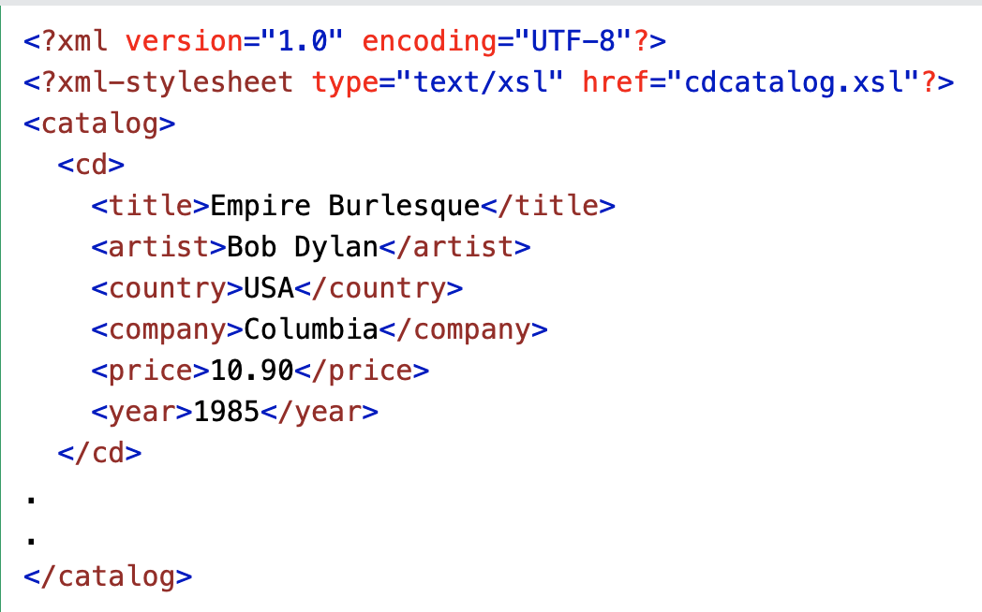
XSL/XSLT
Example with
Linked XML Source: w3schools.com

Slide 13
XSLT Elements
<xsl:value-of>
Extracts the value of the node and output it as string.
<xsl:apply-templates>
element selects a set of nodes in the input tree and instructs the processor to apply the proper templates to them.
<xsl:for-each>
Allows iteration over a specified sequence of items
<xsl:sort>
Used to sort the output in <xsl:for-each> and <xsl:apply-templates>

Slide 14
Workshop
Task
Create an XSL stylesheet to convert the source XML (.pcf) into a table with columns for serial number, department-course number, course title and department name.
Files (starters/solutions) in Omni CMS Sandbox (use this as environment to complete activities)
Requirements
Change the background color of each alternate row
Remove courses with department code ENGLI
Add class = “awesome” to all course titles that contain “and”
Change the background of all courses with class=“awesome”
Sort Department Names alphabetically
Notes:
Notes:
1. Show solution instructons and powerpoint
2. Show courses.pcf where PREVIEW will happen, go over PCF/XML structure and show linked XSL
3. Show working XSL where work will be done
4. Show solutions folder -> TASKS
5. Show solutions folder -> Final product (courses.pcf) and mention solution XSL
6. START task 1

Slide 15
Resources and Additional Support
Need How-To Support?
Email Training
Training@moderncampus.com
https://support.moderncampus.com/technical-reference/index.html
Thank you for attending Evolve 2022!

